Slide 1
Healthy Sierra Leone (HEAL+SL)
National Mortality Platform
Rashid Ansumana, Ronald Carshon-Marsh, Amara Jambai, Sartie Kenneh, Ibrahim Bob Swaray, Anteneh Assalif, Alimatu Vandi, Hellen Gelband, Patrick Brown, Cheryl Chin, Ahmed Osman, Prabhat Jha on behalf of the COMSA Sierra Leone Team
www.comsasl.org
Ministry of Health and Sanitation
Njala University, University of Toronto
COMSA Supported by the Bill and Melinda Gates Foundation, Queen Elizabeth Scholarships and CIHR, Canada

Slide 2
Conclusions
The Healthy Sierra Leone (HEAL-SL) provides reliable ongoing nationally representative cause of death data for Sierra Leone
63% of people in Sierra Leone die prematurely before age 70 years from preventable or treatable causes
In 2020, 22% of all deaths in Sierra Leone were due to malaria, which was the leading cause of death for all age groups except neonates
About 1300 maternal deaths occurred with MMR of 510 (vs 1120 from WHO) per 100,000 livebirths and hemorrhage as the leading cause of death
SEE: WWW.COMSASL.ORG
Text “Join” to COMSA WHATSAPP +232 74800575

Slide 3
What is a Verbal Autopsy?
Investigation of signs, symptoms and events that led to a person’s death (based on the 2016 WHO instrument)
Structured interview with a respondent who lived with the deceased
Surveyor gathers clear and reliable details and writes a narrative of the events

Slide 4
Background & rationale
Sierra Leone’s life expectancy at birth was among the lowest in the world at 54 years in 2019
High under-5 Child (122/1000 livebirths) and estimated maternal mortality (1120/100,000 livebirths) rates in Sierra Leone expose the burden of premature deaths (death before age 70 years) in the country, but cause-specific death rates mostly unknown
Only 25% of all deaths are reported through a centralized vital statistics system
Many deaths occur outside health facilities (mostly at home) without medical attention or documentation of cause of death

Slide 5
Methodology
HEAL-SL covers about 5% of the total population with regional, district and urban/rural level representativeness using 678 census enumeration areas with total population of 343,000
The HEAL-SL instrument has three modules:
Enumeration – collects demographic and vital data
Electronic Verbal Autopsy - to investigate signs, symptoms and events preceding a death in the enumerated household
Re-sampling – random re-check for quality assurance/accuracy
Two stage survey:
sample enumeration
e-VA phase in households with reported deaths below age 70 (now expanded to all ages)

Slide 6
HEAL-SL 2018-2020 Procedure
Census enumerated areas=678 villages or urban blocks
Persons enumerated=343 123
Death below age 70 years during 2018-20 (9033)
Electronic Verbal Autopsy (with automated range checks, 5% random resampling and other quality control steps) by one of 61 trained field staff
Exclude 475 records without an eVA=8558 records randomly assigned anonymously and independently to two of 11 trained physicians
Unable to code 184 records due to missing data
Field reports uploaded daily to server
Both physicians agreed on cause of death
Initial disagreement by two physicians
Anonymous reconciliation by physicians leading to agreement
Persisting differences of two physicians adjudicated anonymously by senior physician
Final ICD-10 code (underlying causes) for 8374 deaths

Slide 7
Map of Sierra Leone showing enumeration areas and numbers of study deaths by regions (currently 4 but expanding to 5 regions in HEAL-SL)

Slide 8
Typical timeline for each survey team of 4
680 EAs to cover; on average each EA will take 4 days to finish
With 11 teams of 4, each team would take ~40 weeks of continuous field work to cover whole country
Optimal schedule in each EA (village) or urban EA
Day 1- sensitize local leaders/draw maps
Day 2 & 3 - Enumerate 100 households (18-25 each surveyor), do VA - about 1-5 per surveyor
Day 4- Resampling (1-2 per surveyor- i.e. 100% to start) plus mop-up of closed areas (locked houses)

Slide 9
FULLY ELECTRONIC FIELD WORK Goal: field work to final COD in <15 days
TL1
S1
#2 Dual coding (physician or senior nurse) + reconciliation (online or offline)
S2
S3
D1
D2
HEAL-SL Cloud
Adjudication if needed
#1 End of day transfer to cloud
#3 Final data, cleaned, available on dashboard
SD3

Slide 10
Quality assurance is key to results remaining credible
IT-based quality assurance
Field-based quality assurance
GPS tracking (and updating maps from Census 2021)
Interview recordings: central audio review (every surveyor per week, random)
Monitor work loads and pace of work using dashboard
Field spot checks (ensure all team members present, confirm number of houses, observe data collection)
Random re-sampling of team work and sample timeframes
Narrative reviews
Weekly experience sharing meetings

Slide 11
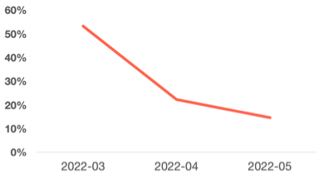
Have interventions implemented since early 2022 improved quality?
Regional supervisor and regular reviews say YES
Change in work culture among surveyors- “shortcuts no longer acceptable and will be caught” and “strong teams need all”
Reduction in % of e-VAs that were rated as “low quality”
Percent
Date

Slide 12
National maternal deaths in Sierra Leone
Maternal deaths in HEAL-SL | 141
% of annual female deaths (15-49 years) | 9.6%
National annual female deaths (15-49 years) | 13 660
Livebirths (2020) | 258 100
Maternal mortality ratio (95% CI) | 510 (483-538) *
Absolute total maternal deaths (95% CI) | 1317 (1247-1389) +
Leading causes of death | %
Hemorrhage | 25%
Infection and sepsis | 15%
Hypertensive disorders | 9%
* WHO estimate of MMR in 2017: 1120
+ eIDSR/maternal facility-based data ~580 maternal deaths in 2018/19

Slide 13
Avoidable mortality estimates for three regions compared to the Western region for children age under 5 years and for ages 5 to 69 years

Slide 14
Leading causes of death for neonates and stillbirths in Sierra Leone, 2018-2020
415 neonatal deaths in HEAL-SL | National annual deaths (%) | Risk of death %
Birth asphyxia/birth trauma | 2550 (32) | 1%
Sepsis and other infections | 2418 (30) | 0.9%
Prematurity and low birthweight | 1596 (20) | 0.6%
Non-communicable causes | 531 (7) | 0.2%
Pneumonia | 267 (3) | 0.1%
Total neonatal deaths | 8018 (100) | 3.1%
154 stillbirths in HEAL-SL
Stillbirths | 4104 (34)

Slide 15
Leading causes of death for children 1-59 months in Sierra Leone, 2018-2020
2322 deaths at 1-59 months in HEAL-SL | National annual deaths (%) | Period risk %
Malaria | 7417 (38) | 2.9%
Other infectious and parasitic | 5545 (28) | 2.1%
Pneumonia | 1481 (7) | 0.6%
Diarrhea | 1606 (8) | 0.6%
Non-communicable causes | 697 (4) | 0.3%
Injuries | 697 (4) | 0.3%
Meningitis/encephalitis | 319 (2) | 0.1%
Measles | 243 (1) | 0.1%
Total 1-59 months | 19704 (100) | 7.6%

Slide 16
Leading causes of death among children 5-14 years in Sierra Leone, 2018-2020
754 deaths at 5-14 years in HEAL-SL | National annual deaths (%) | Period risk %
Malaria | 2119 (34) | 1.0%
Infections and parasitic causes | 1464 (23) | 0.7%
Non-communicable causes | 643 (10) | 0.3%
Injuries | 652 (10) | 0.3%
Diarrhea | 496 (8) | 0.2%
Pneumonia | 221 (4) | 0.1%
Sickle-cell disorders | 285 (5) | 0.1%
Meningitis/encephalitis | 128 (2) | <0.1%
Total 5-14 years | 6227 (100) | 2.9%

Slide 17
Leading causes of death among adults 15-29 years in Sierra Leone, 2018-2020
1192 deaths at 15-29 years in HEAL-SL | National annual deaths (%) | Period risk %
Malaria | 2483 (20) | 1.6%
Other infections | 1311 (11) | 0.9%
Injuries | 1181 (10) | 0.8%
Road traffic accidents | 797 (6) | 0.6%
Diarrhea | 664 (5) | 0.5%
Acute pneumonia | 533 (4) | 0.3%
All vascular causes | 473 (4) | 0.3%
HIV/AIDS and STIs | 474 (4) | 0.3%
Total 15-29 years | 12254 (100) | 7.9%

Slide 18
Leading causes of death among adults 30-69 years in Sierra Leone, 2018-2020
3536 deaths at 30-69 years in HEAL-SL | National annual deaths (%) | Period risk %
Malaria | 4392 (14) | 7.6%
Cardiac/other vascular causes | 3121 (10) | 5.3%
Digestive diseases | 3295 (11) | 5.9%
Stroke | 2503 (8) | 4.3%
Injuries | 1920 (6) | 3.2%
Other infections | 2294 (8) | 4.3%
Diarrhea | 1814 (6) | 3.2%
Acute pneumonia | 1487 (5) | 2.7%
Total 30-69 years | 30736 (100) | 53.5%

Slide 19
Annual malaria mortality rate by age group in Sierra Leone – malaria was a leading cause of death in all age groups except neonates

Slide 20
More than half of malaria deaths occurred in a hospital or after hospitalization
 | Non-malaria deaths | % | Malaria deaths | %
Died in a hospital or health facility | 2740/6473 | 42.3 | 891/1901 | 46.9
Died after discharge from a health facility | 235/6473 | 3.6 | 158/1901 | 8.3
Had a malaria test | 428/5617 | 7.6 | 566/1808 | 31.3
Any treatments received | 4468/6457 | 69.2 | 1614/1899 | 84.9
Oral rehydration salts (n, % of treated) | 1206/4468 | 27.0 | 690/1614 | 42.8
Intravenous fluids | 2253/4468 | 50.4 | 801/1614 | 49.6
Blood transfusion | 358/4468 | 8.0 | 159/1614 | 9.9
Injectable antibiotics | 2234/4468 | 50.0 | 814/1614 | 50.4

Slide 21
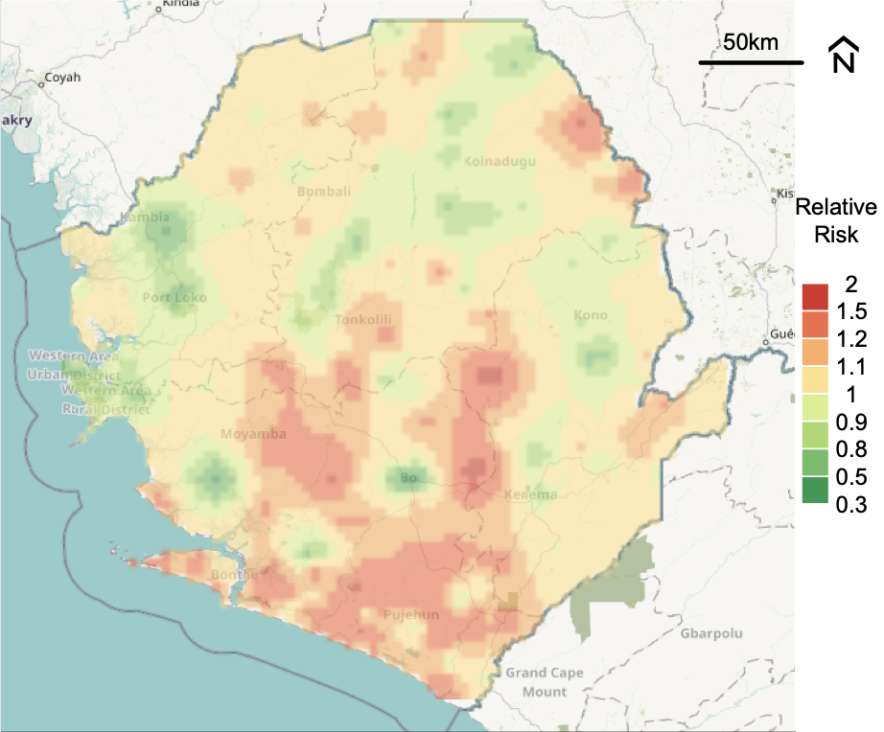
Spatial distribution of malaria death risks (age<70 years) in Sierra Leone, 2018-20

Slide 22
Improvements in HEAL-SL in Phase 2
More focused teams- 45 field staff versus 60, plus attention to re-enumeration, and quality control
Include deaths >70 years, partly to capture COVID
PSUs covered: 661, Population: 412,000 (up from 343,000 in Round 1); Deaths: 3319 (lower death rate than in Round 1, which also oversampled ~4000 deaths in Bo).
Add dried blood spot based studies in Bo district to study various infections including COVID
Phase 3 to start December 5th
Notes:
InterVA 5 and Silco VA 5

Slide 23
Healthy Sierra Leone (HCS) Dried blood spot study:
Investigate the prevalence of exposure (antibodies) to various pathogens including COVID-19 infection using the HEAL-SL platform
Sample frame: 46 enumeration areas in Bo District with ~8,000 people: ~4000 urban adults, ~3000 rural adults, ~1000 kids): 17 dedicated Surveyors
To date: all urban and 1500 rural adults completed, plus 1600 kids
Teams of two trained field staff enumerate/consent households and implement a general health check up about current health, blood pressure, exercise, smoking, alcohol, mental health concerns, and COVID experience
Anthropometric measurements- two x BP, height, weight, waist hip ratio, body impedance (fat) and grip strength
Collect DBS samples (5 spots Whatman paper for central Multiplex analyses), plus anemia/diabetes instant results
Participants representative for age, smoking, BMI, BP vs whole of Sierra Leone

Slide 24
SARS-2-CoV Serosurvey in urban Bo
HCS/DBS study covered about 4200 adults age 18+ randomly selected from about half of Bo urban areas
Field work was in July-Aug 2021 and was not a COVID survey but rather a “healthy lifestyle” survey.
224 of 4200 randomly selected for COVID antibody testing
High quality chemiluminescence ELISA at Sinai Labs, Toronto
3 antigens- RBD, Spike and Nucleocapsid (to reduce false positives)

Slide 25
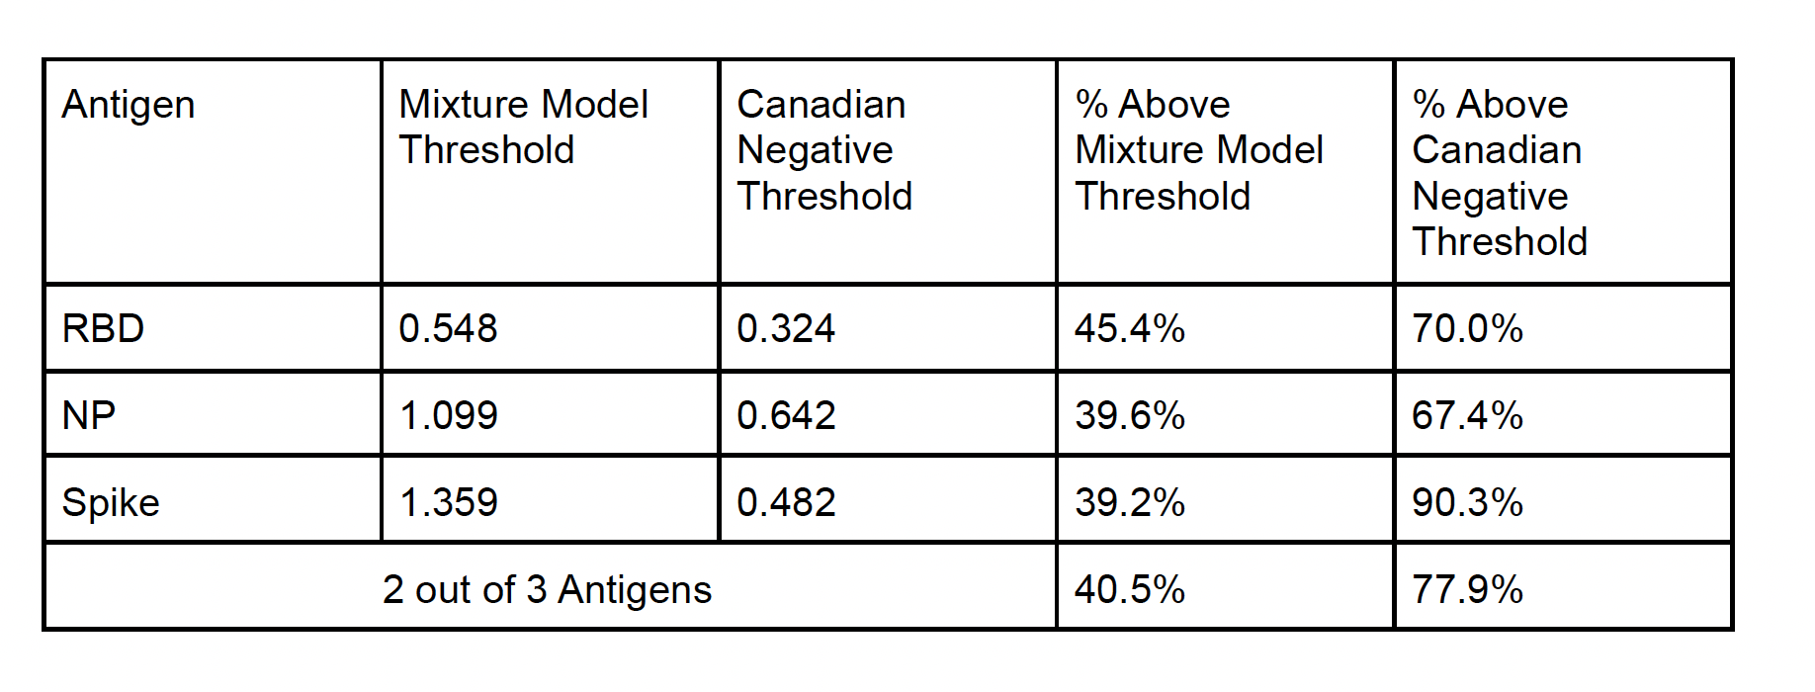
SARS-2-CoV Serosurvey in urban Bo, Sierra Leone (n=224)
Using local cut-offs, 39-45% positivity in July-Aug 2021
Similar high prevalences recorded in other urban African setting

Slide 26
SARS-CoV-2 prevalence in urban adults
Antigen | N = 224 (collected July-Aug 2021, Delta wave)
RBD positive | 157 (70%)
Spike positive | 202 (90%)
RBD + Spike positive | 155 (69%)
Of 77 Delta wave samples, 37 (48%) had significant neutralizing response
43 Pre-Pandemic samples (2019) tested:
RBD +Spike positive: 0 (0%)
Nucleocapsid protein: 11 (26%) but did not differ by malaria parasitemia
Planned analyses:
Repeated serosurvey in same 224 adults (May 2022), assessed Omicron wave (which was additional 20% infection), with generally high persistence of titers. T-cell assay results pending
Compare prevalence with COMSA and other mortality data (currently showing widespread infection, but few COVID/excess deaths during 2021)

Slide 27
Other HEAL-SL achievements
Partnership with CHAMPS- ~200 child deaths underwent MITS at Bo Hospital (plus earlier Makeni site), now moving to ~200 adult deaths in Bo
Full round 1 data on www.comsasl.org , inc. individual level data (Level 2), with efforts to make MPH/other students use data
Working groups on maternal/child health and malaria established, new group on COVID and injuries, HEAL-SL newsletters and WhatsApp user group launched
HEAL-SL/HCS will be core training platform for Njala School of Public Health and Njala Center for Health Research and Implementation
National training capacity, ~ 80 staff trained in e-VA and DBS methods
Advanced Course on Death Certification (facility-based cause of death) completed by ~150 CHOs/MDs
November 29-30 National Mortality Surveillance Conference
Globally competitive D.Ph. to Dr. Marsh via Mastercard Foundation at U of Toronto
Funded by Canadian CIHR to expand DBS solutions to Ghana, Nigeria and Liberia
Partnerships with World Bank on Healthy Longevity and Gender projects

Slide 28
www.cghr.org/training
ACDC for facility deaths- tested on 140 doctors; expanding to Ethiopia, India, Mozambique for ICD-10, taught by Njala University
Field VA training modules- used by 1200 staff, expanding to Ethiopia and Mozambique
Physician Coding for eVA- 450 trained (download, ready now) for any ICD-10
Death 101: Ed-X/U of T free course- 1200 students from 150 countries
Operations manuals: Entire MDS and HEAL-SL

Slide 29
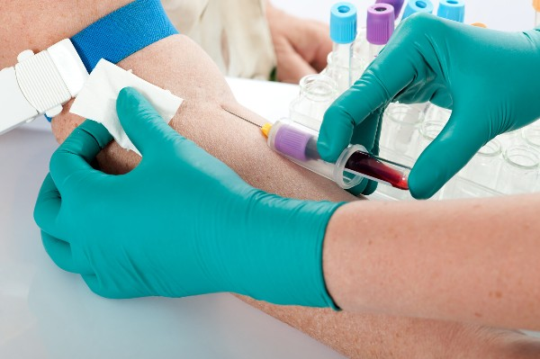
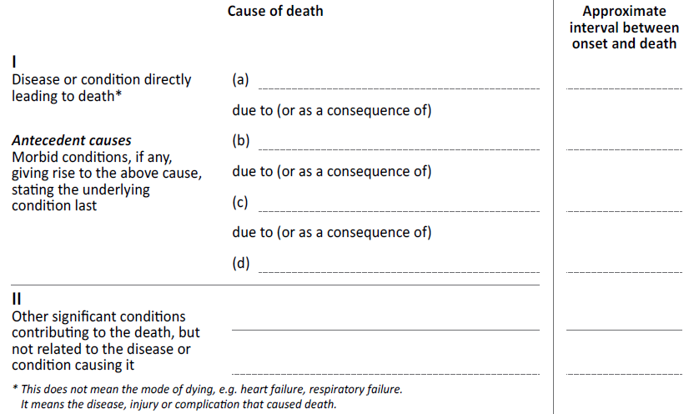
Solution: train, correct X 50
Completing WHO form correctly is like a medical procedure e.g. Venipuncture.
Train 🡪 Repeat x 50 🡪 Feedback
ACDC 🡪 50 Death Certificate Exam (70% to pass) 🡪 Certification

Slide 30
Africa Mortality Symposium
Counting the Dead
Making the Dead Count in Africa
November 29-30, 2022 at Radisson Blu, Freetown, Sierra Leone,
Major presentations from over 10 countries, >25 global participants, plus 50 national
Sessions focused on Maternal and Child Health, Malaria, Infectious Diseases and Closing the Global Morality Divide
First of its kind, with plans for future rounds

Slide 31
Conclusions
The Healthy Sierra Leone (HEAL+SL) provides reliable ongoing nationally representative cause of death data for Sierra Leone
63% of people in Sierra Leone die prematurely before age 70 years from preventable or treatable causes
In 2020, 22% of all deaths in Sierra Leone were due to malaria, which was the leading cause of death for all age groups except neonates
About 1300 maternal deaths occurred with MMR of 510 (vs 1120 from WHO) per 100,000 livebirths and hemorrhage as the leading cause of death
J

Slide 32
Key messages for Sustainability
HEAL-SL requires continuous attention to quality (especially with changes in management or in staff)
Stable sample frame over time
Take into account migration, changing city boundaries
Improve maps for use (Rely on 2021 Mid-Census) updates also
Human resource- motivate staff to do better quality, and let go staff doing poor quality field work (hence IT systems are needed to track quality)
Ongoing training and re-training- Njala University as national/Africa-wide training center
Financial sustainability is good- major cost is of field surveyors, with IT and infrastructure costs falling over time

